Slide 1
Object Oriented Software Engineering (OOSE)
22CS017
Introduction to Interaction Diagrams

Slide 2
Contents
Introduction to Interaction diagrams
Purpose of Interaction Diagrams
Sequence Diagram Notations
How to Create Sequence Diagrams
Challenges of Using Sequence Diagrams
Sequence Diagram Examples

Slide 3
Introduction to Interaction Diagram
An interaction diagram is used to show the interactive behavior of a system. Since visualizing the interactions in a system can be difficult, we use different types of interaction diagrams to capture various features and aspects of interaction in a system.
A sequence diagram simply depicts the interaction between the objects in a sequential order i.e. the order in which these interactions occur.
We can also use the terms event diagrams or event scenarios to refer to a sequence diagram.
Sequence diagrams describe how and in what order the objects in a system function.
These diagrams are widely used by businessmen and software developers to document and understand requirements for new and existing systems.

Slide 4
Introduction to Interaction Diagram
From the term Interaction, it is clear that the diagram is used to describe some type of interactions among the different elements in the model. This interaction is a part of dynamic behavior of the system.
This interactive behavior is represented by two diagrams known as
1. Sequence diagram and
2. Collaboration diagram.
The basic purpose of both the diagrams are similar.
Sequence diagram emphasizes on time sequence of messages and collaboration diagram emphasizes on the structural organization of the objects that send and receive messages.

Slide 5
Purpose of Interaction Diagrams
The purpose of interaction diagrams is to visualize the interactive behavior of the system. Visualizing the interaction is a difficult task. Hence, the solution is to use different types of models to capture the different aspects of the interaction. Sequence and collaboration diagrams are used to capture the dynamic nature but from a different angle.
The purpose of interaction diagram is-
To capture the dynamic behavior of a system.
To describe the message flow in the system.
To describe the structural organization of the objects.
To describe the interaction among objects.

Slide 6
Sequence Diagram Notation
The following notations are used in the Sequence Diagram:-
Actors
Lifelines
Messages
Create message
Delete Message
Self Message
Reply Message
Found Message
Lost Message
Guards

Slide 7
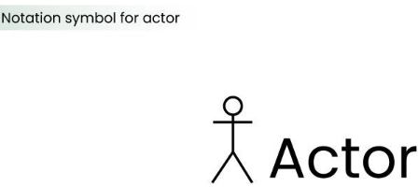
Actors
An actor in a UML diagram represents a type of role where it interacts with the system and its objects. It is important to note here that an actor is always outside the scope of the system we aim to model using the UML diagram.
Figure 1: - Notation Symbol for Actor
We use actors to depict various roles including human users and other external subjects. We represent an actor in a UML diagram using a stick person notation. We can have multiple actors in a sequence diagram.

Slide 8
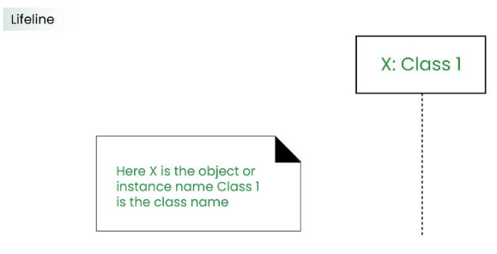
Lifelines
A lifeline is a named element which depicts an individual participant in a sequence diagram. So basically each instance in a sequence diagram is represented by a lifeline. Lifeline elements are located at the top in a sequence diagram. The standard in UML for naming a lifeline follows the following format:
Figure 2: - Notation Symbols for Lifelines

Slide 9
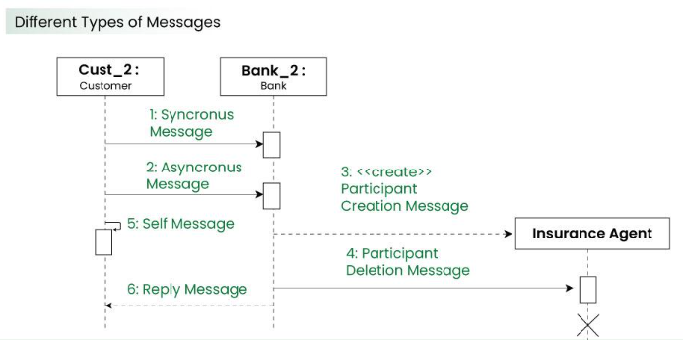
Messages
Communication between objects is depicted using messages. The messages appear in a sequential order on the lifeline.
We represent messages using arrows.
Lifelines and messages form the core of a sequence diagram.
Figure 3: - Notation Symbol for Messages

Slide 10
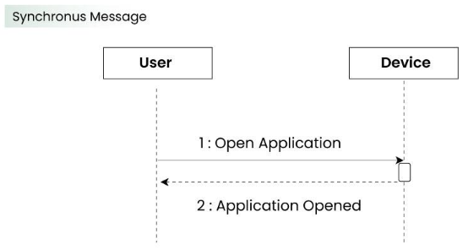
Synchronous Message
A synchronous message waits for a reply before the interaction can move forward. The sender waits until the receiver has completed the processing of the message. The caller continues only when it knows that the receiver has processed the previous message i.e. it receives a reply message.
A large number of calls in object oriented programming are synchronous.
We use a solid arrow head to represent a synchronous message.
Figure 4: - Notation Symbol for Messages

Slide 11
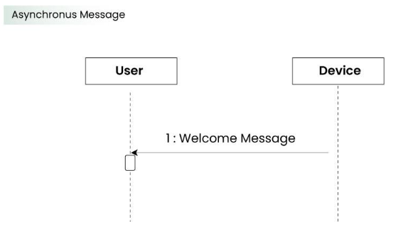
Asynchronous Message
An asynchronous message does not wait for a reply from the receiver. The interaction moves forward irrespective of the receiver processing the previous message or not. We use a lined arrow head to represent an asynchronous message.
Figure 5: - Notation Symbols for Messages

Slide 12
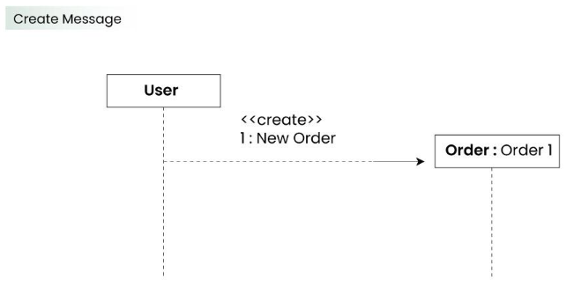
Create Message
We use a Create message to instantiate a new object in the sequence diagram. There are situations when a particular message call requires the creation of an object. It is represented with a dotted arrow and create word labeled on it to specify that it is the create Message symbol. The creation of a new order on a e-commerce website would require a new object of Order class to be created.
Figure 6: - Notation Symbol for Messages

Slide 13
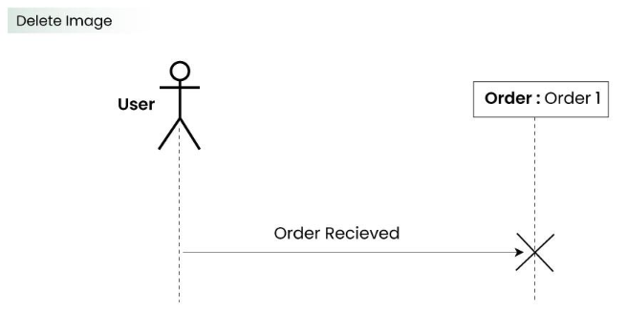
Delete Message
We use a Delete Message to delete an object. When an object is deallocated memory or is destroyed within the system we use the Delete Message symbol. It destroys the occurrence of the object in the system. It is represented by an arrow terminating with a x.
In the scenario below when the order is received by the user, the object of order class can be destroyed.
Figure 7: - Notation Symbol for Messages

Slide 14
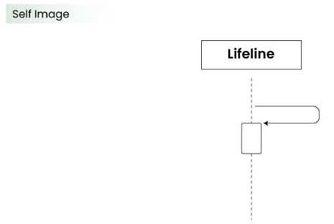
Self Message
Certain scenarios might arise where the object needs to send a message to itself. Such messages are called Self Messages and are represented with a U shaped arrow.
Figure 8: - Notation Symbol for Messages

Slide 15
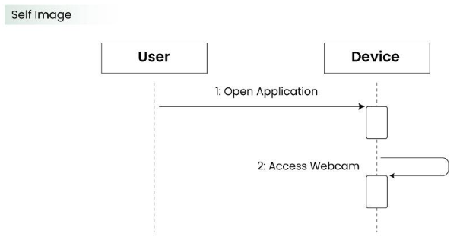
Another Example (Self Message)
Consider a scenario where the device wants to access its webcam. Such a scenario is represented using a self message.
Figure 9: - Notation Symbol for Messages

Slide 16
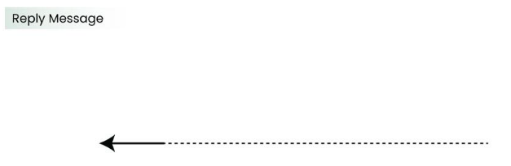
Reply Message
Reply messages are used to show the message being sent from the receiver to the sender. We represent a return/reply message using an open arrow head with a dotted line. The interaction moves forward only when a reply message is sent by the receiver.
Figure 10: - Notation Symbol for Messages

Slide 17
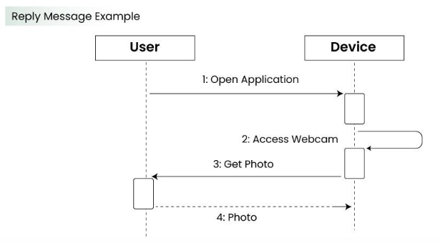
Example
Consider the scenario where the device requests a photo from the user. Here the message which shows the photo being sent is a reply message.
Figure 11: - Example

Slide 18
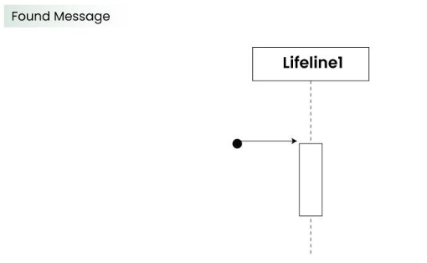
Found Message
A Found message is used to represent a scenario where an unknown source sends the message. It is represented using an arrow directed towards a lifeline from an end point.
Figure 12: - Notation Symbol for Messages

Slide 19
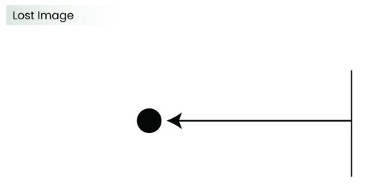
Lost Message
A Lost message is used to represent a scenario where the recipient is not known to the system. It is represented using an arrow directed towards an end point from a lifeline.
Consider a scenario where a warning is generated.
Figure 13: - Notation Symbol for Messages

Slide 20
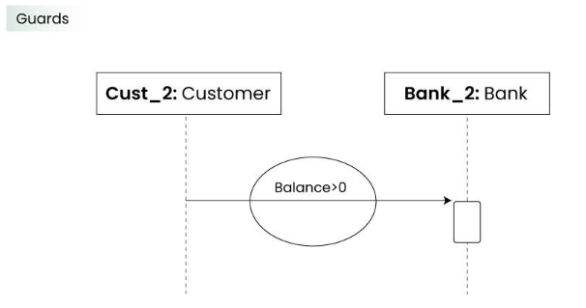
Guards
To model conditions we use guards in UML. They are used when we need to restrict the flow of messages on the pretext of a condition being met. Guards play an important role in letting software developers know the constraints attached to a system or a particular process.
In order to be able to withdraw cash, having a balance greater than zero is a condition that must be met as shown below.
Figure 14: - Notation Symbols

Slide 21
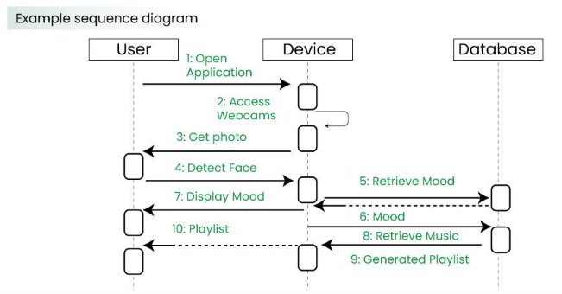
Example
Figure 15: - Example

Slide 22
How to Create Sequence Diagrams
The following things are to be identified clearly before drawing the interaction diagram
Objects taking part in the interaction.
Message flows among the objects.
The sequence in which the messages are flowing.
Object organization.

Slide 23
Step-by-Step to Create Sequence Diagram
Identify the Scenario:
Understand the specific scenario or use case that you want to represent in the sequence diagram. This could be a specific interaction between objects or the flow of messages in a particular process.
List the Participants:
Identify the participants (objects or actors) involved in the scenario. Participants can be users, systems, or external entities.
Define Lifelines:
Draw a vertical dashed line for each participant, representing the lifeline of each object over time. The lifeline represents the existence of an object during the interaction.

Slide 24
Step-by-Step to Create Sequence Diagram
Arrange Lifelines:
Position the lifelines horizontally in the order of their involvement in the interaction. This helps in visualizing the flow of messages between participants.
Add Activation Bars:
For each message, draw an activation bar on the lifeline of the sending participant. The activation bar represents the duration of time during which the participant is actively processing the message.
Draw Messages:
Use arrows to represent messages between participants. Messages flow horizontally between lifelines, indicating the communication between objects. Different types of messages include synchronous (solid arrow), asynchronous (dashed arrow), and self-messages.

Slide 25
Step-by-Step to Create Sequence Diagram
Include Return Messages:
If a participant sends a response message, draw a dashed arrow returning to the original sender to represent the return message.
Indicate Timing and Order:
Use numbers to indicate the order of messages in the sequence. You can also use vertical dashed lines to represent occurrences of events or the passage of time.
Include Conditions and Loops:
Use combined fragments to represent conditions (like if statements) and loops in the interaction. This adds complexity to the sequence diagram and helps in detailing the control flow.

Slide 26
Step-by-Step to Create Sequence Diagram
Consider Parallel Execution:
If there are parallel activities happening, represent them by drawing parallel vertical dashed lines and placing the messages accordingly.
Review and Refine:
Review the sequence diagram for clarity and correctness. Ensure that it accurately represents the intended interaction. Refine as needed.
Add Annotations and Comments:
Include any additional information, annotations, or comments that provide context or clarification for elements in the diagram.

Slide 27
Step-by-Step to Create Sequence Diagram
Document Assumptions and Constraints:
If there are any assumptions or constraints related to the interaction, document them alongside the diagram.
Tools:
Use a UML modeling tool or diagramming software to create a neat and professional-looking sequence diagram. These tools often provide features for easy editing, collaboration, and documentation.

Slide 28
Challenges of Using Sequence Diagrams
Complexity and Size: As systems grow in complexity, sequence diagrams can become large and intricate. Managing the size of the diagram while still accurately representing the interactions can be challenging, and overly complex diagrams may become difficult to understand.
Abstraction Level: Striking the right balance in terms of abstraction can be challenging. Sequence diagrams need to be detailed enough to convey the necessary information, but too much detail can overwhelm readers. It’s important to focus on the most critical interactions without getting bogged down in minutiae.
Dynamic Nature: Sequence diagrams represent dynamic aspects of a system, and as a result, they may change frequently during the development process. Keeping sequence diagrams up-to-date with the evolving system can be a challenge, especially in rapidly changing or agile development environments.

Slide 29
Challenges of Using Sequence Diagrams
Ambiguity in Messages:
Sometimes, it can be challenging to define the exact nature of messages between objects. Ambiguity in message content or meaning may lead to misunderstandings among stakeholders and impact the accuracy of the sequence diagram.
Concurrency and Parallelism:
Representing concurrent and parallel processes can be complex. While sequence diagrams have mechanisms to indicate parallel execution, visualizing multiple interactions happening simultaneously can be challenging and may require additional diagrammatic elements.
Real-Time Constraints:
Representing real-time constraints and precise timing requirements can be challenging. While sequence diagrams provide a sequential representation, accurately capturing and communicating real-time aspects might require additional documentation or complementary diagrams.

Slide 30
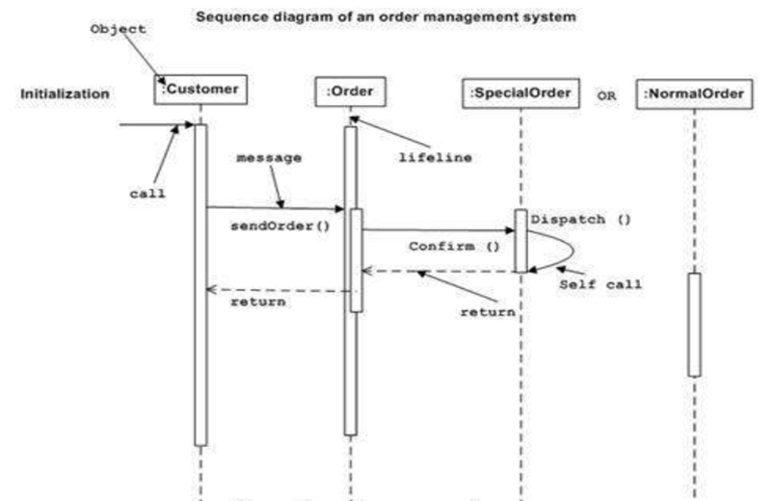
Example: Sequence Diagram of Order Management System
Figure 16: - Example of Order Management System

Slide 31
Cont..
The sequence diagram has four objects (Customer, Order, Special Order and Normal Order).
The following diagram shows the message sequence for Special Order object and the same can be used in case of Normal Order object. It is important to understand the time sequence of message flows. The message flow is nothing but a method call of an object.
The first call is sendOrder () which is a method of Order object. The next call is confirm () which is a method of Special Order object and the last call is Dispatch () which is a method of Special Order object. The following diagram mainly describes the method calls from one object to another, and this is also the actual scenario when the system is running.

Slide 32
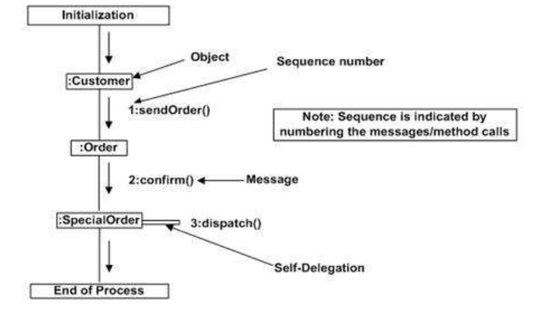
Interaction Diagram (Collaboration Diagram-Order Management System)
Figure 17: - Example

Slide 33
Interaction Diagram (Sequence Diagram)
Some examples

Slide 34
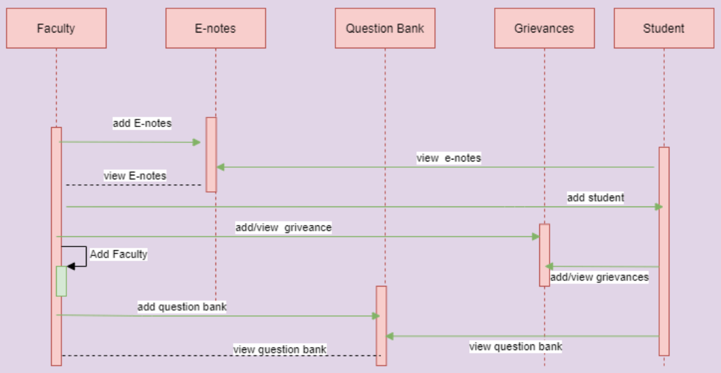
College Management System

Slide 35
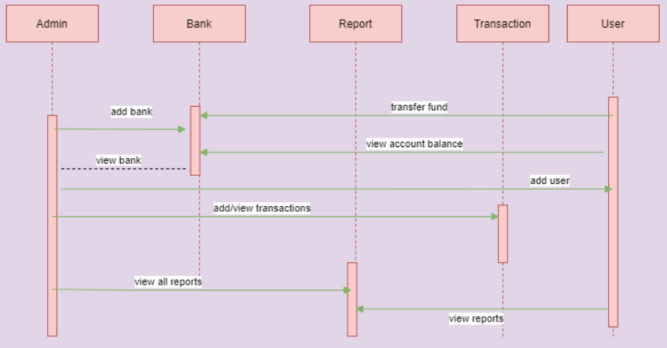
Banking System

Slide 36
Practice Questions ?
Draw the sequence diagram of Railway Reservation System.
Draw the sequence diagram of Library Management system.
Draw the sequence diagram of Hospital Management System.
Draw the collaboration diagram for Banking System.

Slide 37
Bibliography
https://www.tutorialspoint.com/uml/uml_interaction_diagram.htm
https://www.geeksforgeeks.org/unified-modeling-language-uml-sequence-diagrams/
https://www.tutorialspoint.com/software_testing_dictionary/alpha_testing.htm

